Slide 1

Proposal Project Presentation
DS102 and DS104

Slide 2
Table of Content
Project Objective
Data Cleaning and Key terms
Questions
Conclusion
Limitations

Slide 3
1. Project Objective
To determine and predict which type of resale HDB and area gives you the best rental yield.

Slide 4
2. Data set
Dataset 1 - resale-flat-jan-2017-jan-2021.csv
Source : https://data.gov.sg/dataset/resale-flat-prices
Dataset 2 - median-rent-by-town-and-flat-type.csv
Source : https://data.gov.sg/dataset/median-rent-by-town-and-flat-type

Slide 5
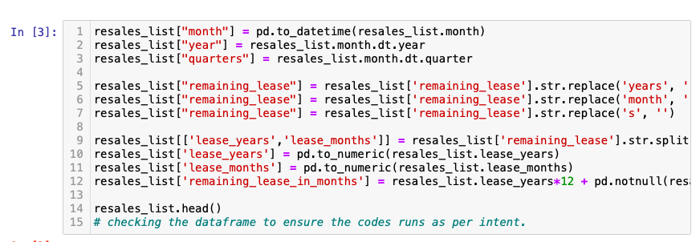
2. Data Cleaning
Creation of year and quarter
Creation of remaining lease in months

Slide 6
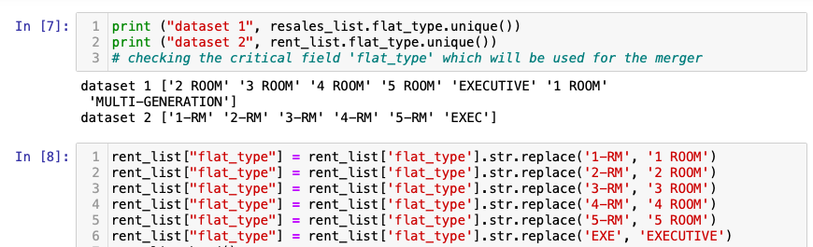
2. Data Cleaning
Standardise the flat type

Slide 7
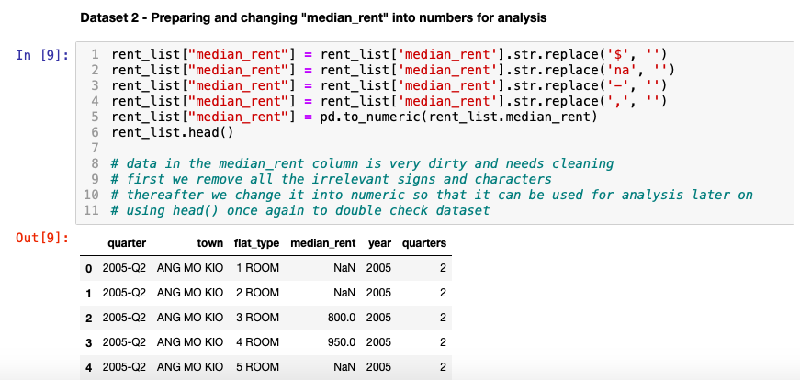
2. Data Cleaning
Make median rent into number

Slide 8
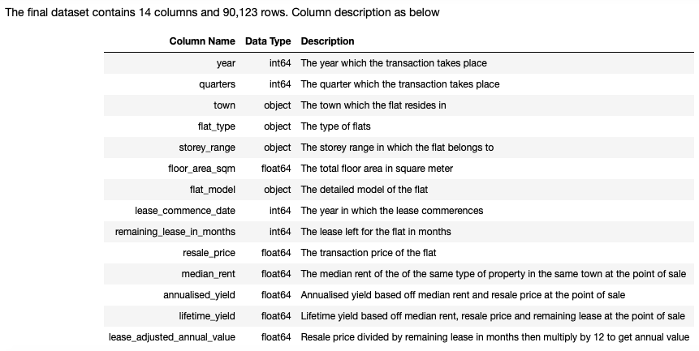
2. Key terms

Slide 9
3. Questions
Is there any area with high density of high/low priced HDB?
Is there any meaningful trend on the lease-adjusted resale price?
Is there any meaningful trend on the median rental?
Is there any seasonal effect in prices and rental?
Is there any meaningful trend between resale price and storey range?
Is the resale prices following the bala curve?
Is there any meaningful tend on the annualised/lifetime yield?
Is there any strong corelation between the attributes?

Slide 10
Where to buy

Slide 11
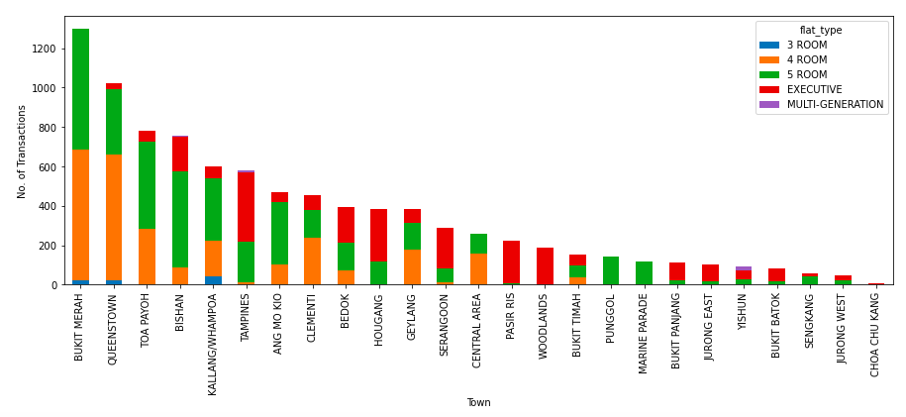
i) Is there any area with high density of high/low priced HDB?
- Top 10% of all transactions

Slide 12
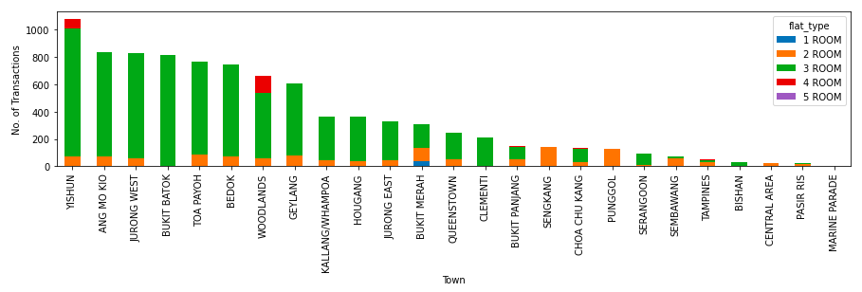
i) Is there any area with high density of high/low priced HDB?
- Bottom 10% of all transactions

Slide 13
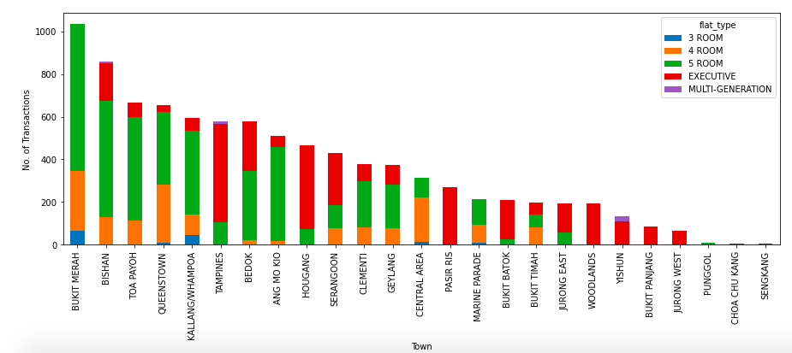
ii) Is there any meaningful trend on the lease-adjusted resale price?
- Top 10% of all transactions

Slide 14
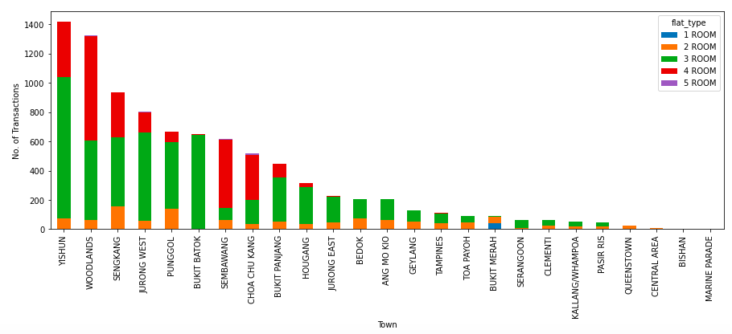
ii) Is there any meaningful trend on the lease-adjusted resale price
- Bottom 10% of all transactions

Slide 15
Key takeaway
Resale Price | Lease adjusted
Bukit Merah | Bukit Merah
Queenstown | Bishan
Toa Payoh | Toa Payoh
Bishan | Queenstown
Kallang/Whampoa | Kallang/Whampoa
Resale Price | Lease adjusted
Yishun | Yishun
Ang Mo Kio | Woodland
Jurong West | Sengkang
Bukit Batok | Jurong West
Toa Payoh | Punggol
Top expensive location– Bukit Merah
Least expensive location - Yishun

Slide 16
iii) Is there any meaningful trend on the median rental?

Slide 17
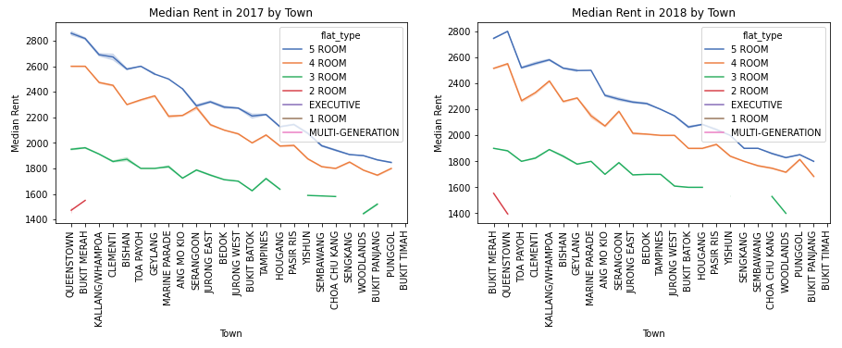
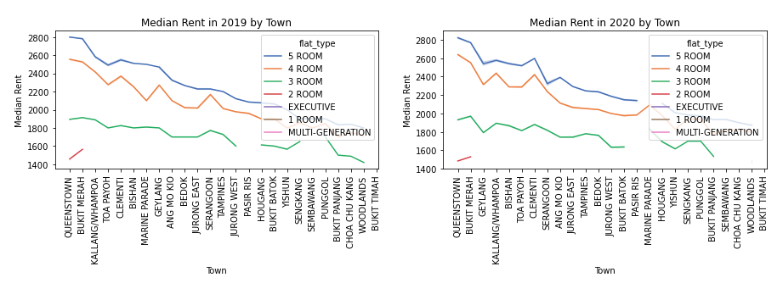

Slide 18
Recap
High Resale Price | High rent
Bukit Merah | Bukit Merah
Bishan | Queenstown
Toa Payoh | Clementi
Queenstown | Bishan
Kallang/Whampoa | Kallang/Whampoa
Low resale Price | Low Rent
Yishun | Bukit Timah
Woodland | Bukit Panjang
Sengkang | Woodland
Jurong West | Punggol
Punggol | Chua Chu Kang
High potential area
Yishun
Sengkang
Jurong West
Potential area
Toa Payoh
Clementi
Not looking good
Bukit Timah
Bukit Panjang
Chua Chu Kang

Slide 19
Which type of flats to buy

Slide 20
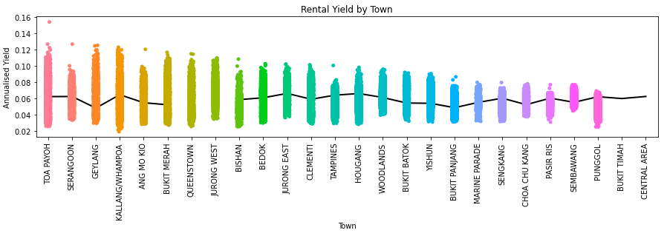
vi) Is there any meaningful tend on the annualised/lifetime yield?

Slide 21
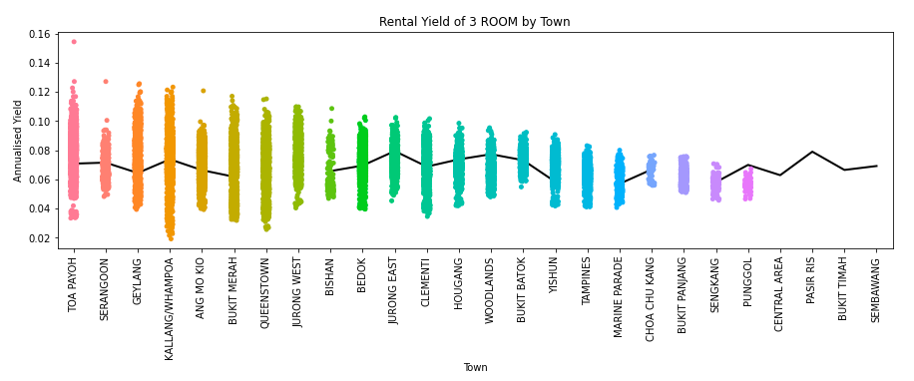
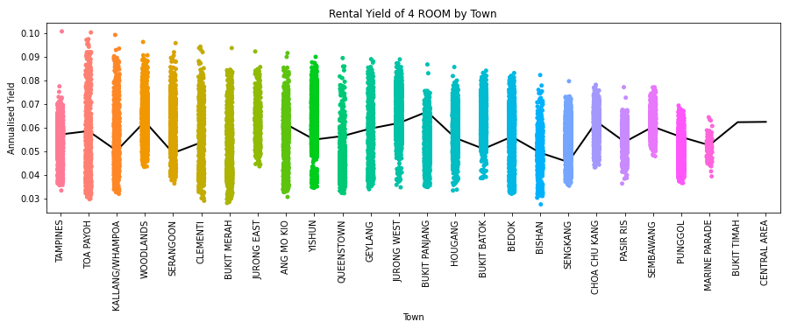
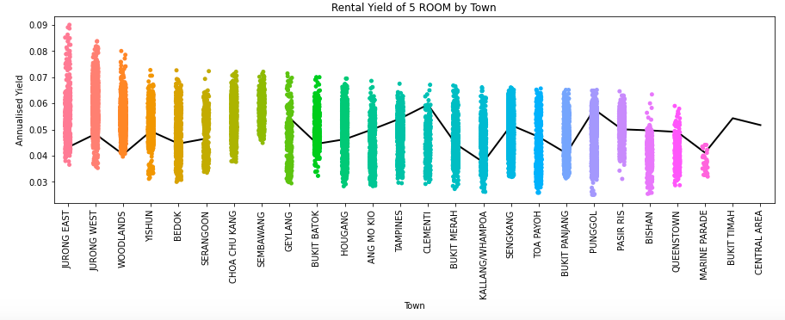
No Meaningful trend
Notes:
No conclusion

Slide 22
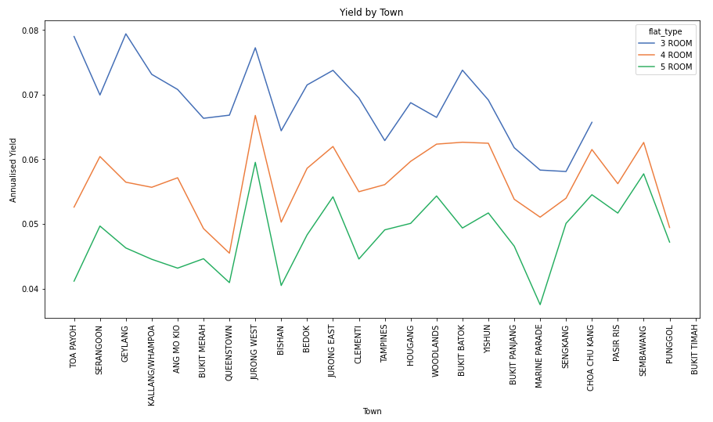
Notes:
No conclusion

Slide 23
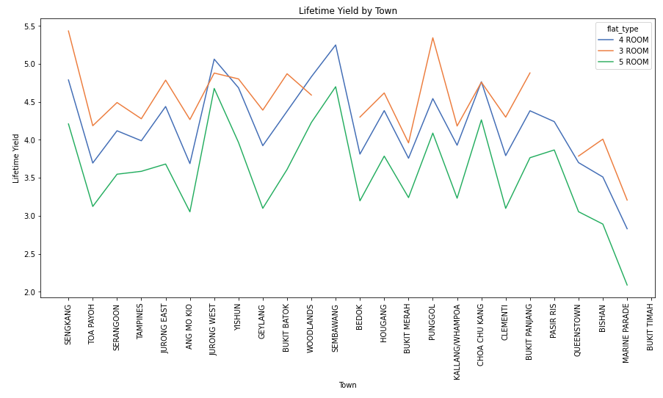
Notes:
No conclusion

Slide 24
Recap
3-room and 4-room gives the best returns
Based off lifetime yield, you can 4x-5x your money if you rent out the flat for the entire duration of the lease
Based on point 3, renting a house would be a terrible idea

Slide 25
When to buy

Slide 26
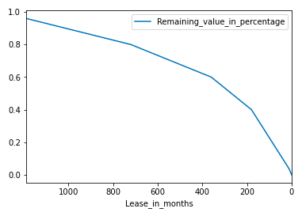
vii) Is the resale prices following the bala curve?

Slide 27
Bala Curve
When Singapore was still a British colony, the British Land office needed a way to work out the fees for renting of state land for a long period of time. At around that time a Land Office employee named Bala came up with a table (also called Bala’s Curve in graph form), which acted as a sort of guideline for the price renting out state land. Over time, Bala’s Table/Curve made its way to the real estate market in general A fresh 99% lease will start at 96% of it's value and it drops to 80% when lease drops to 60 years remaining. At 30 years remaining lease, the value becomes 60%, at 15 years it becomes 40% and eventually dropping to 0%

Slide 28
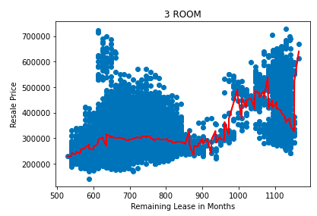
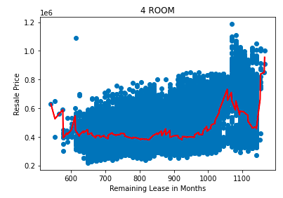
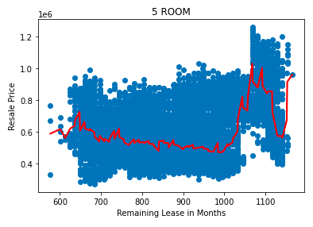
Buy 3-room with around 80 years lease
Buy 4-room, 5-room with around 85 years lease

Slide 29
Other Insights

Slide 30
iv) Is there any seasonal effect in prices and rental?

Slide 31
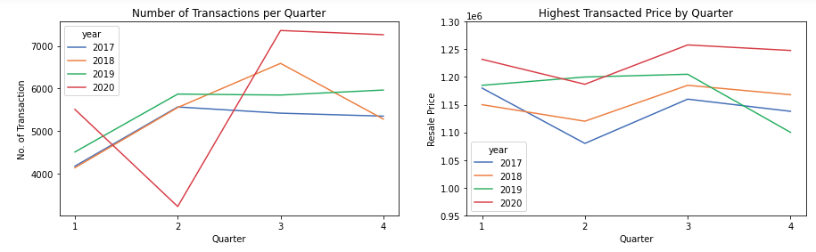
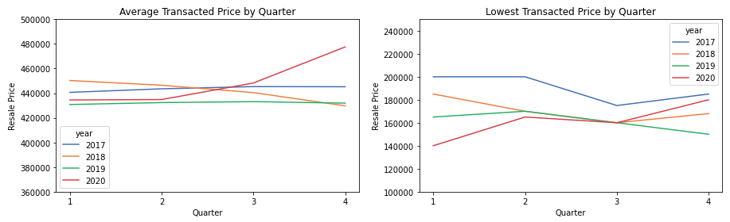
No Meaningful trend
Notes:
No conclusion

Slide 32
v) Is there any meaningful trend between resale price and storey range?

Slide 33
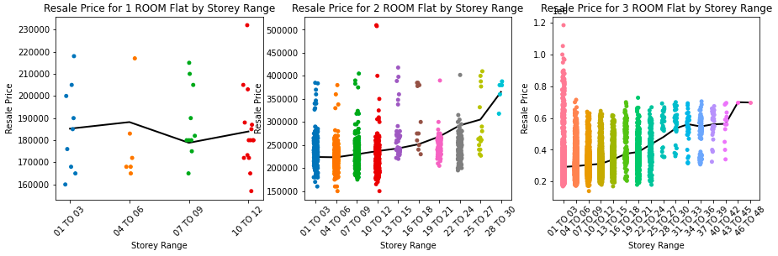
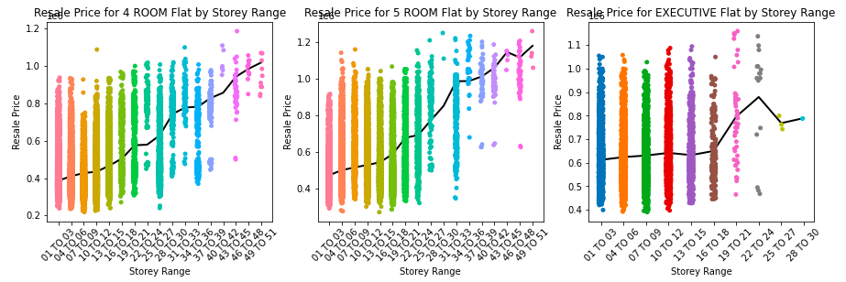
Notes:
No conclusion

Slide 34
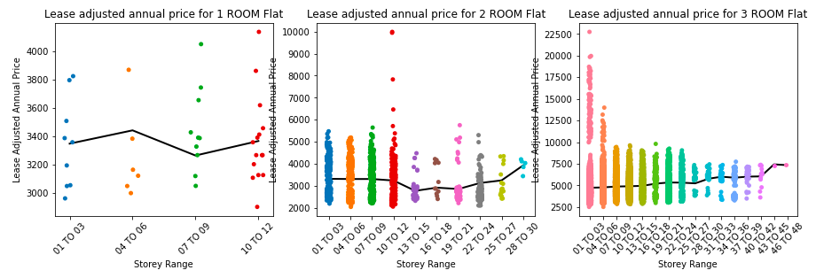
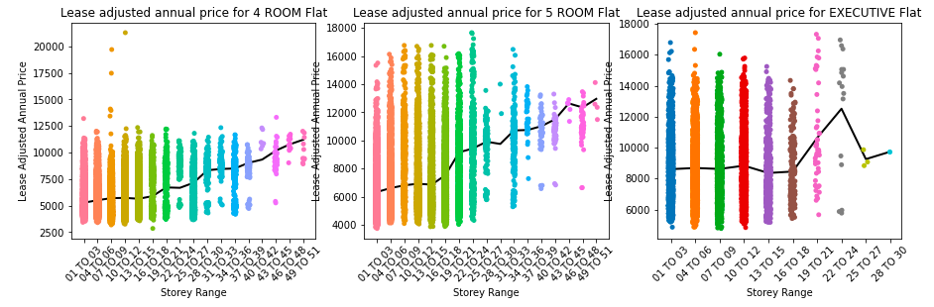
Notes:
No conclusion

Slide 35
Key takeaway
Indeed there is a trend between high floor and resale price
It is less prominent in 1-room, 2-room and 3-room flats
It gets obvious once we go to 4-room and 5-room flats
The lease-adjusted value is less exaggerated as compared to a direct comparison against the resale price

Slide 36
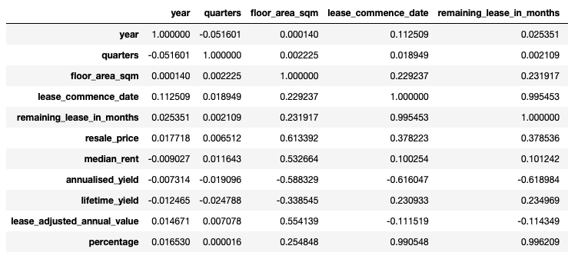
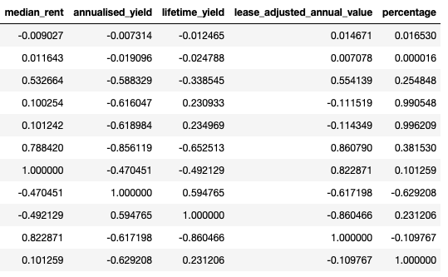
viii) Correlations

Slide 37
4. Conclusion
High priced flats doesn’t guarantee high yet
3-room and 4-room gives the best returns
Based off lifetime yield, you can 4x-5x your money if you rent out the flat for the entire duration of the lease
Based on point 3, renting a house would be a terrible idea
Jurong West and Sembawang gives the best lifetime yield, followed by Sengkang and Punggol, then Chua Chu Kang

Slide 38
4. Conclusion-cont
Buy a 3-room with 80 years lease or 4-room with 85-years lease as the price flats out till 50 year mark. Effectively giving you a free 30 years and 35 years respectively.
Based on point 6, a possible strategy would be to buy a 3-room with 80 years lease and sell it when it is approaching the 50 years mark. As the is effectively no depreciation, you would maximise your returns
Based on point 6, another strategy would be to buy a 4-room with 85 years lease and sell it when it is approaching the 50 years mark. As the is effectively no depreciation, you would maximise your returns

Slide 39
5. Limitations
Median rent data is too general, as such, even with high correlation between price, storey range and floor size, I cannot determine which storey range gives the best yield
The rent data is by town, so I cannot pinpoint exact locations with good yield

